Slide 1

CQRS 1O1
A practical Introduction

Slide 2
CQRS: the origin
Evolved from CQS (command query separation) by Bertrand meyer in 1986
Defined in 2011 by Martin fowler
MEANS “Command Query responsibility segregation”

Slide 3
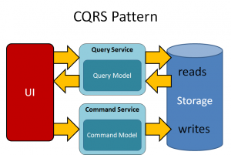
10k ft view
A service to handle customer requests
A WRITE-side data store
A bus to notify the changes
A read-side data store
Handlers to write the read side
Presentation services
Shared services

Slide 4
Actors model
This is a system like the one obtain following the now ubiquitous “actor model”
Interactions only through messages
State is saved only inside the single actor
Actor separated from the domain in a DDD way
Every interaction is managed through messages – commands and events within the cqrs pattern

Slide 5
Base classes-C#
public interface IBus { void Send(Object message); void RegisterTopic<T>(Action<T> handler); void RegisterQueue<T>(Action<T> handler); void AddListener(Action<Object> listener); }
public interface IRepository<T> where T : IEntity { void Delete(Guid id); Guid Save(T toUpdate); IEnumerable<T> GetAll(Func<T, bool> query = null); T GetById(Guid id); }
public interface IScheduler { void Register(TimeSpan span, Action<DateTime> action); }
public interface IOptimisticRepository<T> : IRepository<T> where T:IOptimisiticEntity { T GetByIdVersion(Guid Id, long version); }
Notes:
Action<T> equivalent to Java’s Consumer<T> and Func<T,K> equivalent to Java’s Function<T,K>
Guid equivalent to Java’s UUID
The IRepository<T> where T:IEntity is equivalent to java RepositoryInterface<T extends EntityInterface>

Slide 6
Conventions
Xxx.Domain
Command handler and its storage
Xxx.shared
Commands
Events
Service interfaces
Xxx.PROJECTIONS
Query service and event handlers implementations
XXX.exposed
Services exposed by the domain
Xxx.EXTERNALS
Layer to isolate services in ZZZ.EXPOSED as a proxy

Slide 7

CommandS
The Command is an “order”
Expressed as imperative
Create cruise
Contains the minimum data to execute the order

Slide 8
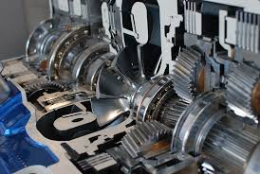
COMMAND HANDLERS
Handle the execution of the command
Contains all the core business logic
Store the “single source of truth”
Is the only semantic validator of the command
Save the modified data and send an event
Can be Pretty complex
Optimized for writing (optimistic lock)
Notes:
Atomic save->nosql

Slide 9

EVENTS
The event is a notification of a fact
Expressed as past tense
Cruise created
Denotes something happened in the past
Contains all the data needed to understand the fact happened

Slide 10

PROJECTIONS
OR ‘event handlers’
The projections are “materialized views”
Should be kept simple
Optimized to read data
Usually without validation
One for each “read” use case
Notes:
No validation but to check if the event is successful
Can be at the same time: repo, event handler and API service

Slide 11
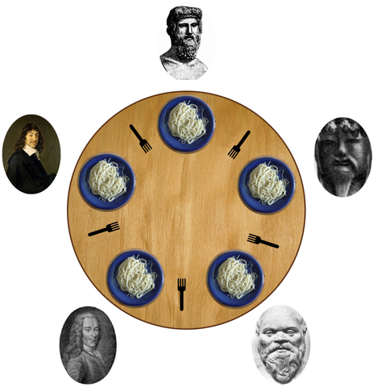
Optimistic Lock
The main data is subject to concurrent modification
The easiest solution is the optimistic lock
The record has a version
We can update an object only if the version is equal (we had read the same version
Pretty efficient
Can be used even in NoSQL storages

Slide 12
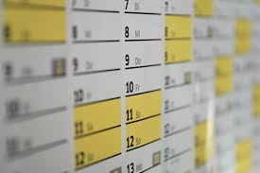
Scheduler
Every domain is responsible for its part of the transaction
The internal items are handled synchronizing the expirations
The external items are flooded with cancellation requests until they give an answer
Not needed when the “delayed send Is available”
Notes:
As an alternative to delayed messages

Slide 13
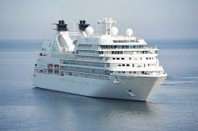
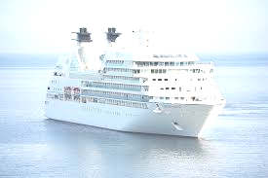
Cqrs-01, CRUISE domain
Command handler
Create a cruise
Create a cruise room
Block the creation of duplicate room numbers
Rooms projection
List all the available rooms of a given class
Notes:
Commands, CH Test, Events, PRJ Test

Slide 14
Referencing external items
All references external to the domain must be by id
This is valid for both
Other cqrs entities
Crud-based entities
For consistency, their deletion must be only logical
For special values the concept of “VALUE OBJECT” is used
A value whose id is the object itself
A value that must be stored as is
Think about an invoice address
Kept forever
Changing the user data does not change it
Notes:
Can use complex structures on both read and write side, the latter e.g. to keep an old database while migrating to cqrs
There will be an API like https://host/api/create/cruise, https://host/api/create/room https://host/api/rooms/{tripId}

Slide 15

Cqrs-02, invoices and customers
Command handler
Create an invoice
Finalize an invoice
The invoice is linked with a customer
The invoice own the billing address
Even for regulation purposes
Customer exposes services to the rest of the world. The invoice domain use its own proxy implementation
The customer data is used by other domains
Can’t be deleted physically
Each domain implements its way to access the customer exposed services
Notes:
Commands, CH Source, Exposed and External, Test, only the domain-local customer service is mocked

Slide 16
“Distributed” transactions
Or Sagas
Every transaction-controlled domain has
Expiration date
A scheduled job to cleanup
A command to cleanup
Has an index on expiration date
The coordinator, often reach the dignity of a separate domain
can be implemented as a state machine
Is cleaned when expired
Has the responsibility to reset external state when cleaned
The project managed resources are cleaned via the expiration

Slide 17

Cqrs-03, purchases and payments
We created a specific domain for the purchase instead of adding its logic to the products or to the payment service
The purchase domain know how to control payment and warehouse domains
This is a “saga”
Cancelling a reserving item will simply set it to failed, sending a failed purchase event
Cancelling a paying item will send a cancellation request to PayPal
Our PayPal will send back an unsuccessful payment going back on main path
Notes:
Warehouse, PayPal, Commands

Slide 18
Cqrs-03, purchases and payments
When a purchase expire, the corresponding reservation expire
Both purchase and reservation are cleaned up by the scheduler
Their expiration date is synchronized
When A purchase in paying status expire the scheduler sends “payment cancellation requests” till the end of time
It continues until it reaches a state where the expiration is handled “internally”
Usually this would be implemented with a state machine

Slide 19

CQRS-04, the red pill
Notes:
Basic: https://docs.particular.net/tutorials/quickstart/
Sagas: https://docs.particular.net/samples/saga/simple/
Delayed delivery: https://docs.particular.net/nservicebus/messaging/delayed-delivery
Rabbit delayed messages: https://www.cloudamqp.com/docs/delayed-messages.html

Slide 20
nservicebus
Real service bus
Can send delayed messages
Can handle sagas
Automatically register the handlers
Can be configured to use several transport (e.g. RabbitMQ, SqlServer etc.)
We use the default di from .NET CORE
Registering the repositories
Configuring the NSB endpoints
Using the “dev” nsb channel
An API will be added to request commands
A BDD - SpecFlow suite is added

Slide 21

References
Eric Evans, Domain-Driven Design, Addison-Wesley, 2003
Jimmy Nilsson, Applying Domain-Driven Design and Patterns, Pearson, 2006
Vaughn Vernon, Implementing Domain Driven Design, Pearson, 2013
NServiceBus, https://particular.net/nservicebus
Martin Folwer, https://martinfowler.com/
Jimmy Bogard, https://jimmybogard.com/

Slide 22
Thank you for your time
Enrico Da Ros:
E-mail: edr@kendar.org
Linkedin: https://www.linkedin.com/in/enricodaros/
Slides and code: https://github.com/kendarorg/CQRS101

